Slide 1
Crimes against data sharing in functional genomics
Emma Bell, PhD
Princess Margaret Cancer Centre, Toronto
emma.bell@uhnresearch.ca
@emmabell42
Notes:
Share the data not the pain

Slide 2
Introduction
What is functional genomics?
Why should we share our data?
What are some common hurdles working with public functional genomics data?
Notes:
I’m a computational biologist

Slide 3
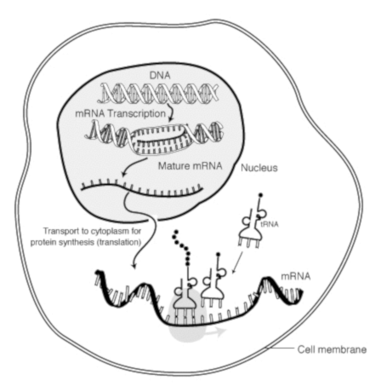
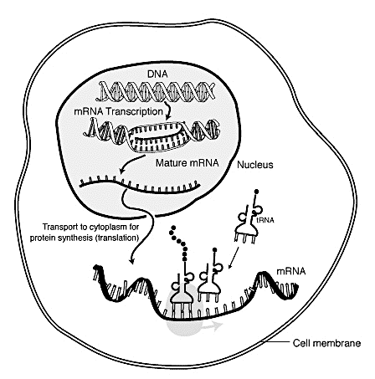
What is functional genomics?
Functional genomics uses high-throughput biological data to answer questions about dynamic biological processes.
For example:
What predisposes a person to a given type of cancer?
Can we identify any biomarkers of a given cancer?
Which biological pathways go awry during a given type of cancer?
Notes:
Proteins do things
To synthesise proteins you start with a single DNA molecule, generate many RNA intermediates, finally output protein.
In genomics we’re interested in the identity and abundance of DNA and RNA.
We design experiments that assay these molecules

Slide 4
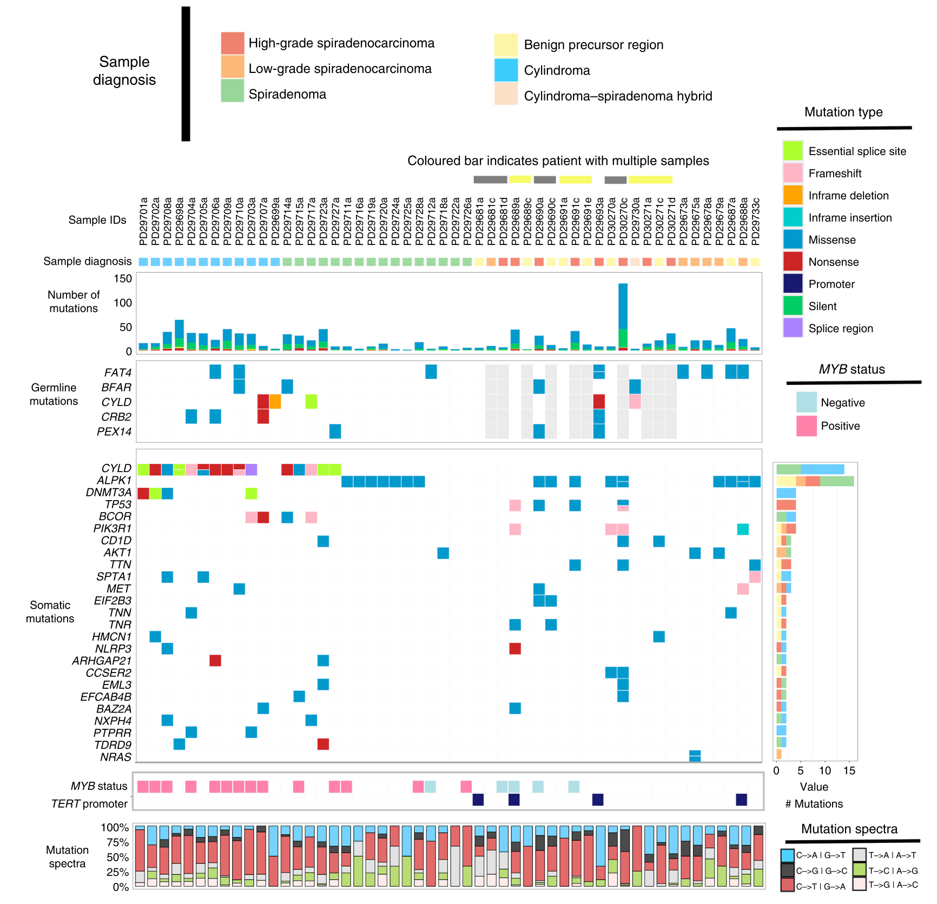
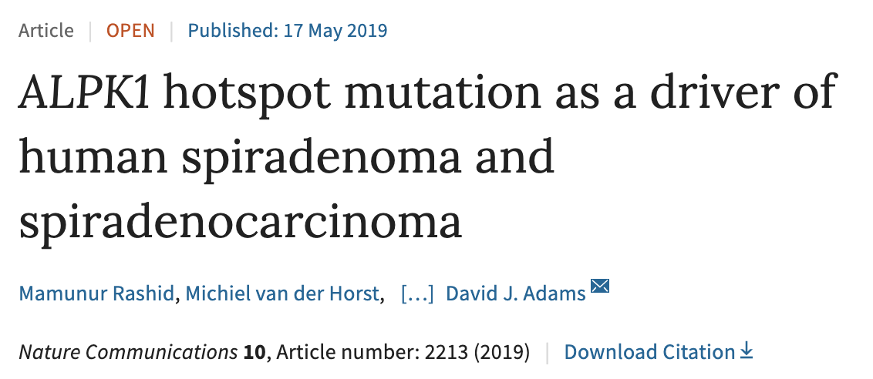
A recent example
Whole genome sequencing of 57 patients with a rare and aggressive skin tumour
164 sequenced samples in total
Rashid, M. et al. Nat. Commun. 10, 2213 (2019).
Notes:
Tagged “cancer genomics”
Each column represents a patient. The first row indicates what type of tumour they have. The remaining information pertains to hereditary mutations, non-heridiatary mutations, the type of mutation that occurs.

Slide 5
What does functional genomics data look like?
DNA microarrays
Older and cheaper technology
Require prior sequence information of the genes or transcripts that you want to assay
Output numeric data
I.e. a table with ~25,000 rows and at least 1 column per sample
Notes:
Results in a seemingly infinite number of custom arrays that require special normalisation and QC.

Slide 6
What does functional genomics data look like?
Next-generation sequencing
Newer and more expensive technology
Does not necessarily require prior sequence knowledge
Outputs data as sequences with quality scores
FASTQ format:
@SEQ_ID
GATTTGGGGTTCAAAGCAGTATCGATCAAATAGTAAATCCATTTGTTCAACTCACAGTTT
+
!''*((((***+))%%%++)(%%%%).1***-+*''))**55CCF>>>>>>CCCCCCC65

Slide 7
How much does sequencing cost?
Human Genome Project (2001)
US $2,700,000,000
23 and Me (2019)
CA $129
Notes:
Dramatic decrease in the cost of sequencing over time

Slide 8
How much does a sequencing experiment cost?
Histological Subtype Specific Epigenetic Risk For Ovarian Cancer Using Whole Genome Bisulphite Sequencing
James Flanagan, PhD and Ed Curry, PhD, Imperial College London
Study design:
891 cases and matched controls
Aim to sequence 30-50 million reads
Costs:
DNA sample acquisition = CA $24,270.96
DNA sample processing = CA $31,213.09
Sequencing = CA $114,018.21
Data analysis = CA $25,959.72
Data storage = CA $7,286.14
Total = CA $202,827.80
Low-grade
High-grade
Jones, P. M. & Drapkin, R. Front. Oncol. 3, (2013).
Notes:
That doesn’t mean that sequencing experiments are cheap.
Study I worked on last year with colleagues at Imperial College London.
The aim of the study was to compare and contrast different kinds of ovarian cancer.

Slide 9
Why should we share our data?
To ensure our experiments are reproducible
To allow others to repurpose our data
Empowers researchers with more limited resources
Gets the most out of precious biological samples (e.g. rare disease samples)
Reduces redundant experiments
The research reproducibility crisis (?)
Fanelli, D. Proc. Natl. Acad. Sci. U. S. A. 115, 2628–2631 (2018).

Slide 10
What public repositories exist?
INSDC
The International Nucleotide Sequence Database Collaboration (INSDC)
National Centre for Biotechnology Information (NCBI)
Sequence Read Archive (SRA)
Gene Expression Omnibus (GEO)
European Bioinformatics Institute (EBI)
European Nucleotide Archive (ENA)
ArrayExpress
DNA Databank of Japan (DDJB)
DDBJ Sequence Read Archive (DRA)
China’s Genome Sequence Archive (GSA)
Genome Sequence Archive (GSA)
Trace Archive
NCBI
GEO SRA
EBI
ArrayExpress ENA
SRA (INSDC)
DDJB
DRA
GSA
GSA
Wheeler, K. Childhood Cancer Data Lab Blog (2019). Available at: https://www.ccdatalab.org/blog/2019/3/29/gene-expression-repos-explained

Slide 11
Public genomics databases can be confusing to navigate
NCBI GEO accessions
Original data
GSM – sample
GSE – series
GPL – platform
Lightly curated data
GDS – data set

Slide 12
How much data is in those repositories?

Slide 13
What are some common hurdles in using publicly available functional genomics data?
Databases can be confusing to navigate
The accompanying metadata can be incoherent, inconsistent, and/or incomplete
Researchers withhold data

Slide 14
Incoherent, inconsistent, and incomplete metadata
What metadata are we talking about?
What is the sample?
Where did it come from?
How was the experiment conducted?

Slide 15
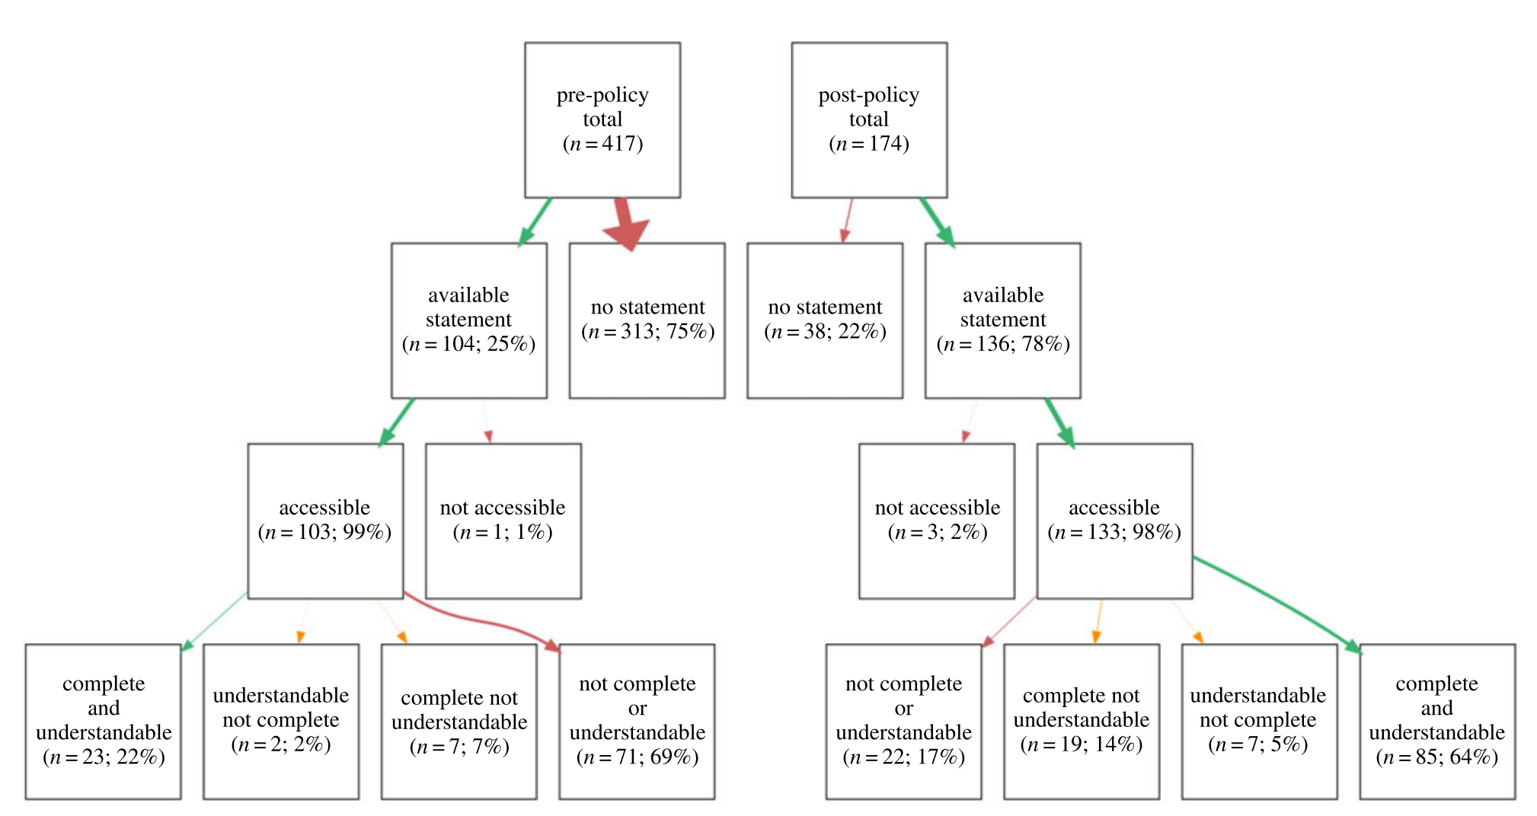
Incoherent, inconsistent, and incomplete metadata
Hardwicke TE et al. 2018 Data availability, reusability, and analytic reproducibility: evaluating the impact of a mandatory open data policy at the journal Cognition. R. Soc. open sci. 5: 180448. http://dx.doi.org/10.1098/rsos.180448

Slide 16
Incoherent, inconsistent, and incomplete metadata
age
Age
age (yrs)
age (years)
age (y)
age in years
age_years
AGE
age(years)
age (year)
age (yr)
Age (years)
age (years)
age [y]
age [years]
Age(yrs.)
age.year
age (yr-old)
age(yrs)
age of patient
Age, year
Age (yrs)
Age of patient
age, years
`Age
Age (Years)
age (after birth)
age, yrs
age of subjects
Prof Michel Dumontier (@micheldumontier), Maastricht University, via @neuronJoy. Available: https://twitter.com/neuronJoy/status/1027616795279028225

Slide 17
Incoherent, inconsistent, and incomplete metadata
Case 1
Control 2
Case 2
Control 1
Control 3
Case 3

Slide 18
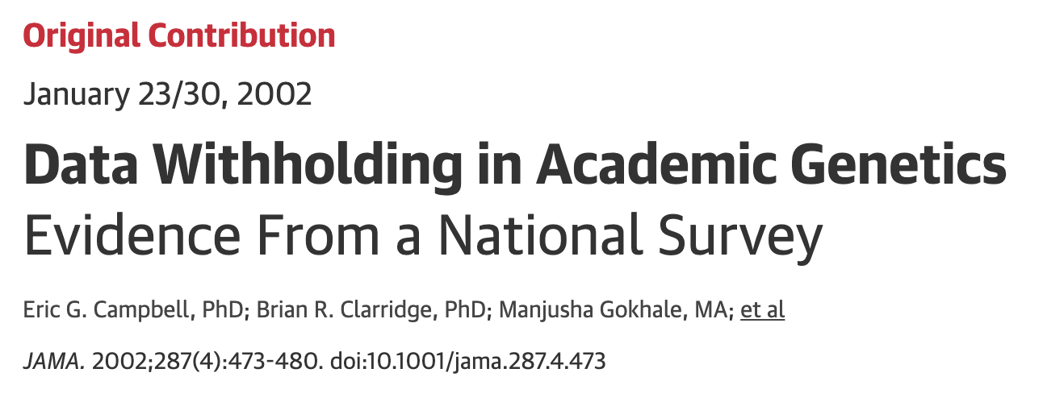
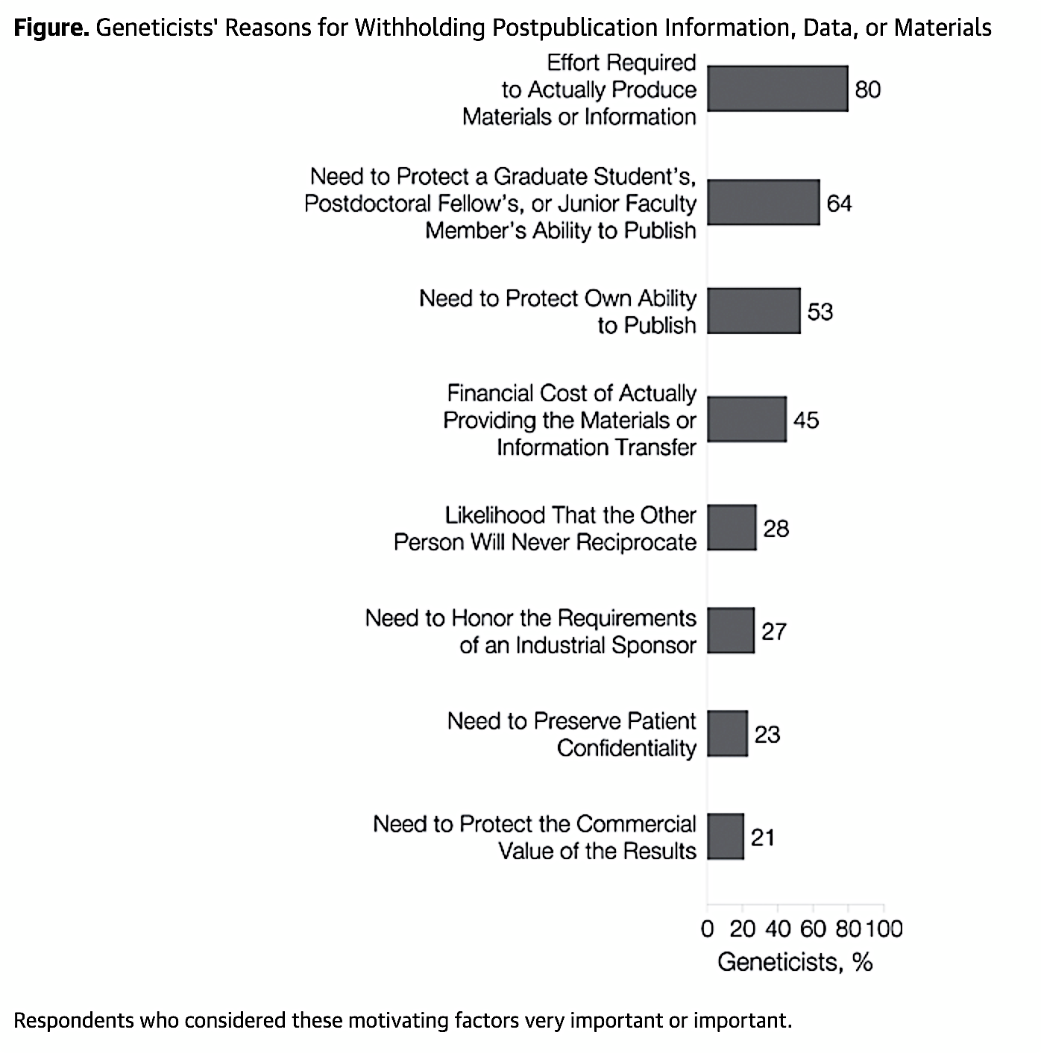
Researchers withhold data
Survey of 2,893 geneticists
Including all members of the Human Genome Project
1,849 responded (64%)
84% of respondents requested data. Of those 47% reported data withholding.
Campbell, E. G. et al. JAMA 287, 473 (2002).

Slide 19
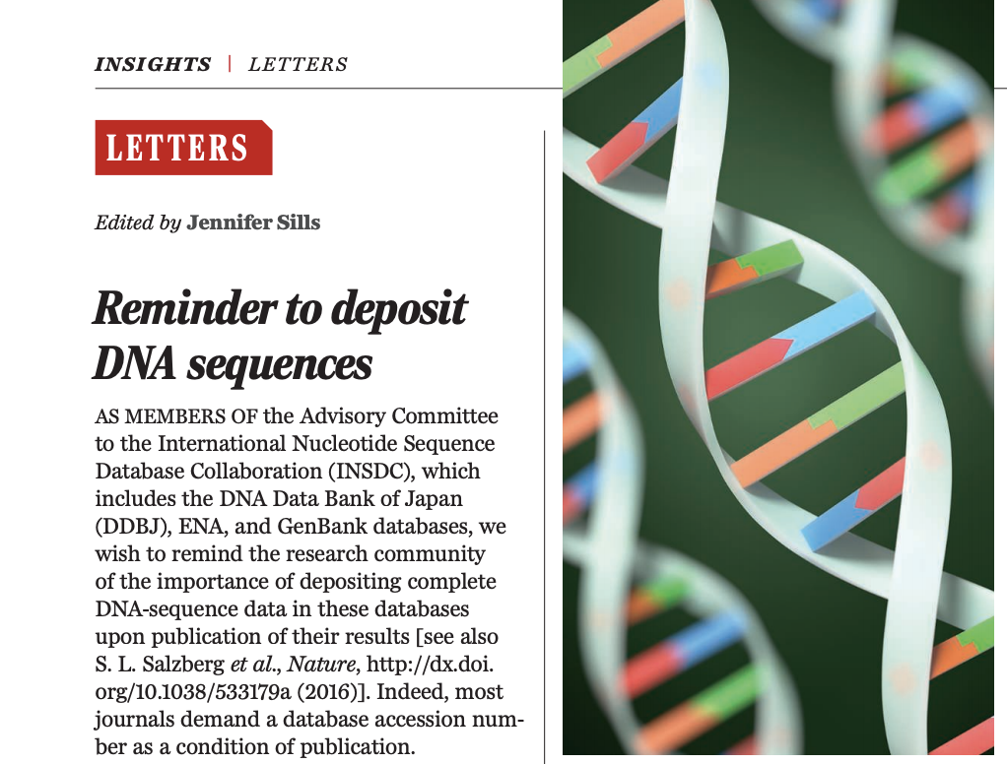
Researchers still withhold data
Reminder to deposit DNA sequences By Mark Blaxter, Antoine Danchin, Babis Savakis, Kaoru Fukami-Kobayashi, Ken Kurokawa, Sumio Sugano, Richard J. Roberts, Steven L. Salzberg, Chung-I Wu Nature 12 May 2016 533 : 179 | Science 13 May 2016 : 780

Slide 20
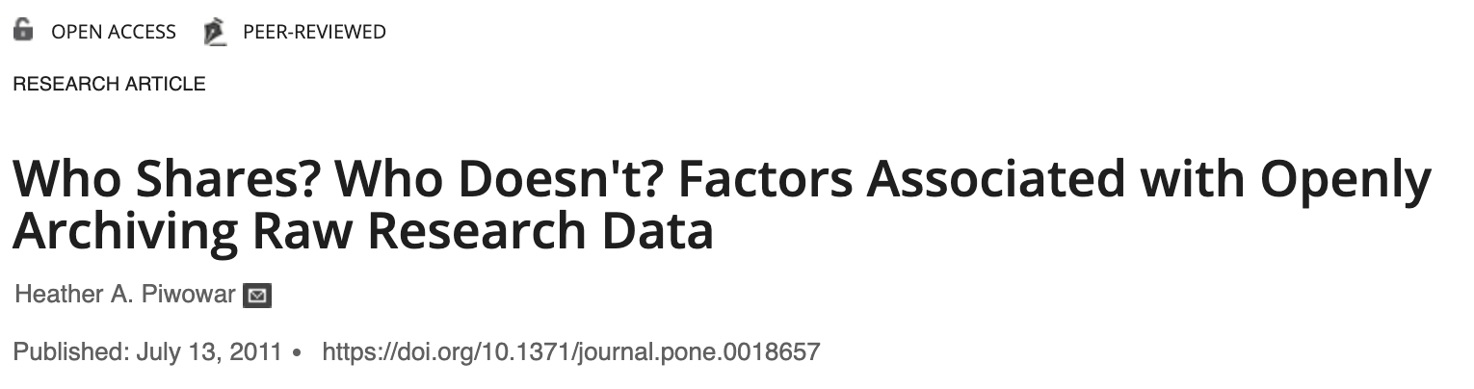

Researchers still withhold data
Identified 11,603 papers published between 2000 and 2009 containing microarray data
Data sharing has increased over time
The best predictor of data sharing is previous data sharing
The worst predictor is cancer research on human samples
Odds ratios of data sharing
Piwowar, H. A. PLoS One 6, e18657 (2011).

Slide 21
How do we encourage researchers to share data?
We make data sharing a prerequisite for:
Funding applications
Publication
We regard it good research practice for all researchers to consider at the research proposal stage how they will manage and share the data they will generate. Therefore, we require that applicants applying for funding provide a data management and sharing plan as part of their application. This plan will be reviewed as part of the funding decision.
Cancer Research UK. Submission of a data sharing and preservation strategy (2019). Available at: https://www.cancerresearchuk.org/funding-for researchers/applying-for-funding/policies-that-affect-your-grant/submission-of-a-data-sharing-and-preservation-strategy

Slide 22
Does marrying data sharing to money encourage researchers to release their data?
Hardwicke TE et al. 2018 Data availability, reusability, and analytic reproducibility: evaluating the impact of a mandatory open data policy at the journal Cognition. R. Soc. open sci. 5: 180448. http://dx.doi.org/10.1098/rsos.180448

Slide 23

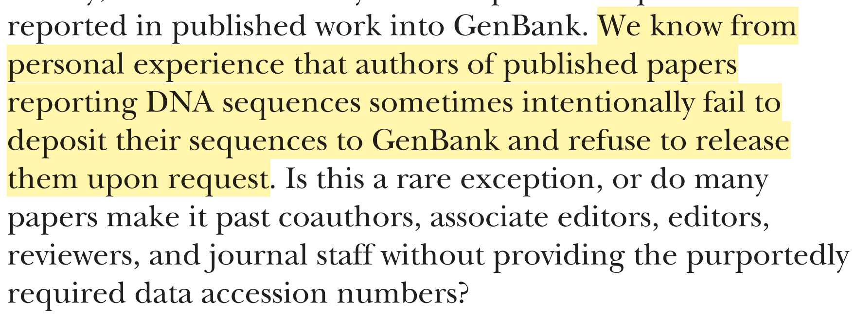
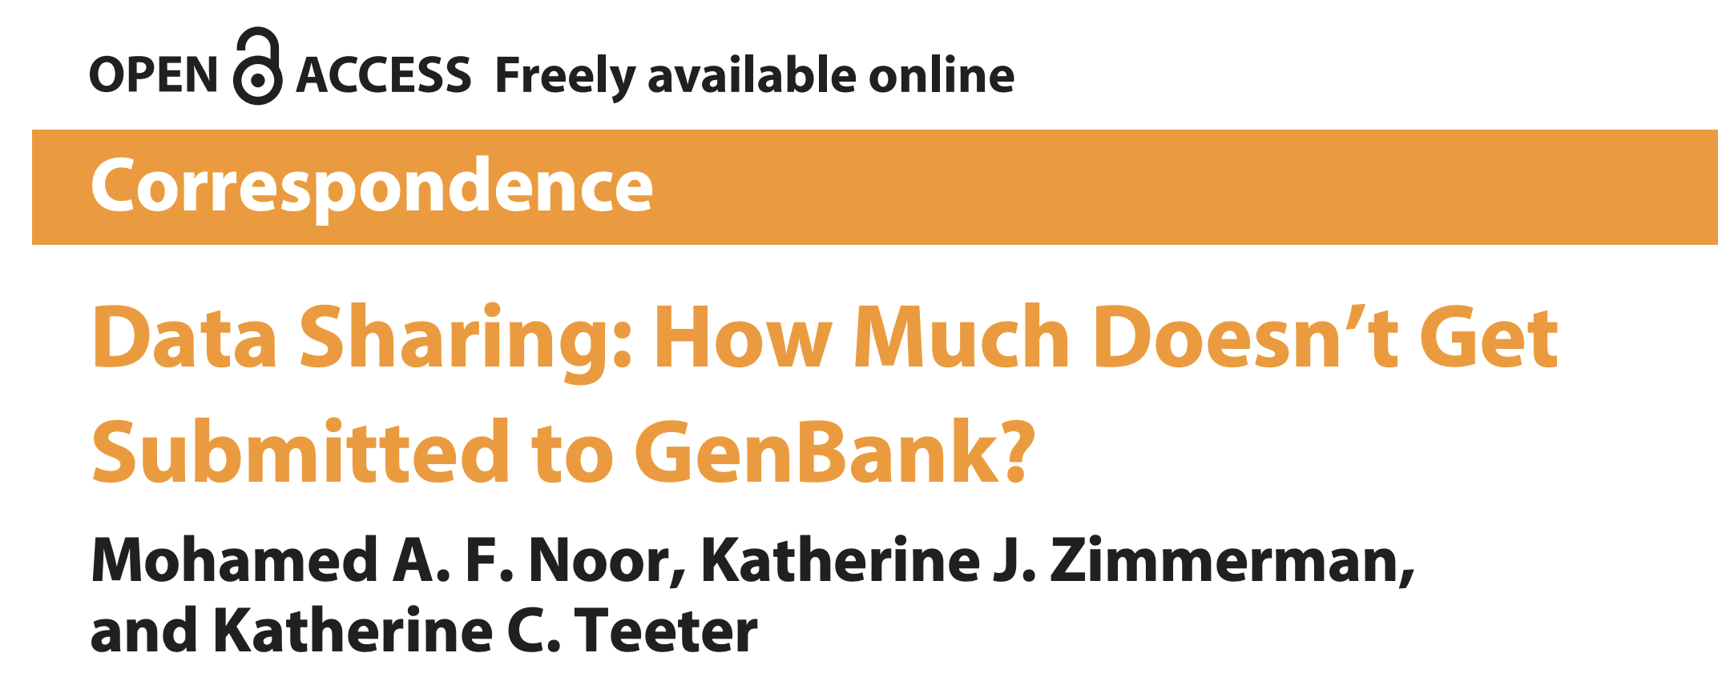
Does marrying data sharing to money encourage researchers to release their data?
Noor, M. A. F., Zimmerman, K. J. & Teeter, K. C. PLoS Biol. 4, e228 (2006).

Slide 24
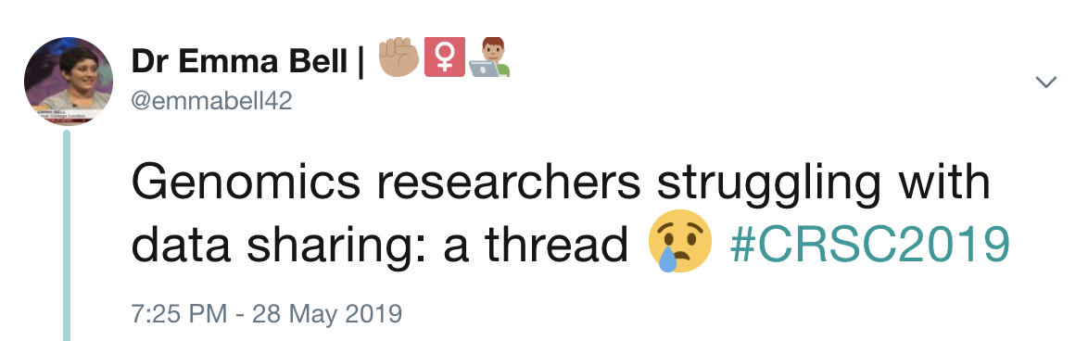
Does that work?
Click here
https://twitter.com/emmabell42/status/1133439189519876097

Slide 25
What are some common hurdles in using publicly available functional genomics data?
Databases can be confusing to navigate
The accompanying metadata can be incoherent, inconsistent, and/or incomplete
Researchers withhold data

Slide 26
Why is data sharing in functional genomics such a big problem?
Poor widespread understanding of:
Research data management
Open data
Findable Accessible Interoperable Reusable (FAIR) data
Higman, R., Bangert, D. & Jones, S. Insights UKSG J. 32, (2019).

Slide 27
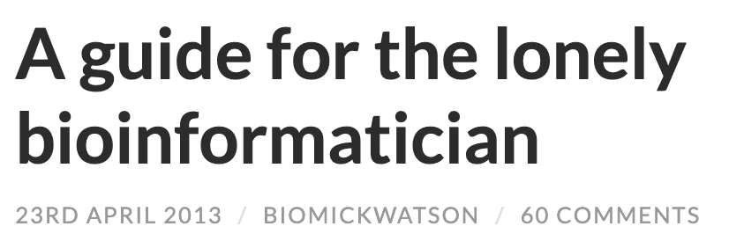
Why is data sharing in functional genomics such a big problem?
pet bio·​in·​for·​mat·​ician
/pet ˌˈbī-ō-in-​fər-​mə-​ˈti-​shən/
noun (computing)
“a single bioinformatician employed within a laboratory based group”
“Don’t worry”, the lead PI said, “we’ve put money on the application to fund a [pet] bioinformatician.”
Watson, M. Opiniomics (2013). Available at: http://biomickwatson.wordpress.com/2013/04/23/a-guide-for-the-lonely-bioinformatician/

Slide 28
References
Rashid, M. et al. Nat. Commun. 10, 2213 (2019).
Wheeler, K. Childhood Cancer Data Lab Blog (2019). Available at: https://www.ccdatalab.org/blog/2019/3/29/gene-expression-repos-explained
Fanelli, D. Proc. Natl. Acad. Sci. U. S. A. 115, 2628–2631 (2018).
Hardwicke, T. E. et al. R. Soc. Open Sci. 5, 180448 (2018).
Campbell, E. G. et al. JAMA 287, 473 (2002).
Salzberg, S. L. Nature 533, 179–179 (2016).
Cancer Research UK. Submission of a data sharing and preservation strategy (2019). Available at: https://www.cancerresearchuk.org/funding-for researchers/applying-for-funding/policies-that-affect-your-grant/submission-of-a-data-sharing-and-preservation-strategy
Noor, M. A. F., Zimmerman, K. J. & Teeter, K. C. PLoS Biol. 4, e228 (2006).
Higman, R., Bangert, D. & Jones, S. Insights UKSG J. 32, (2019).
Watson, M. Opiniomics (2013). Available at: http://biomickwatson.wordpress.com/2013/04/23/a-guide-for-the-lonely-bioinformatician/

